Slide 1
Python

Slide 4
Workshop Agenda
Primitive Data Types and Operations
Lists, Tuples, Sets, and Dictionaries
Functions
Math
OS module
Glob module
Control Flow
Class

Slide 5
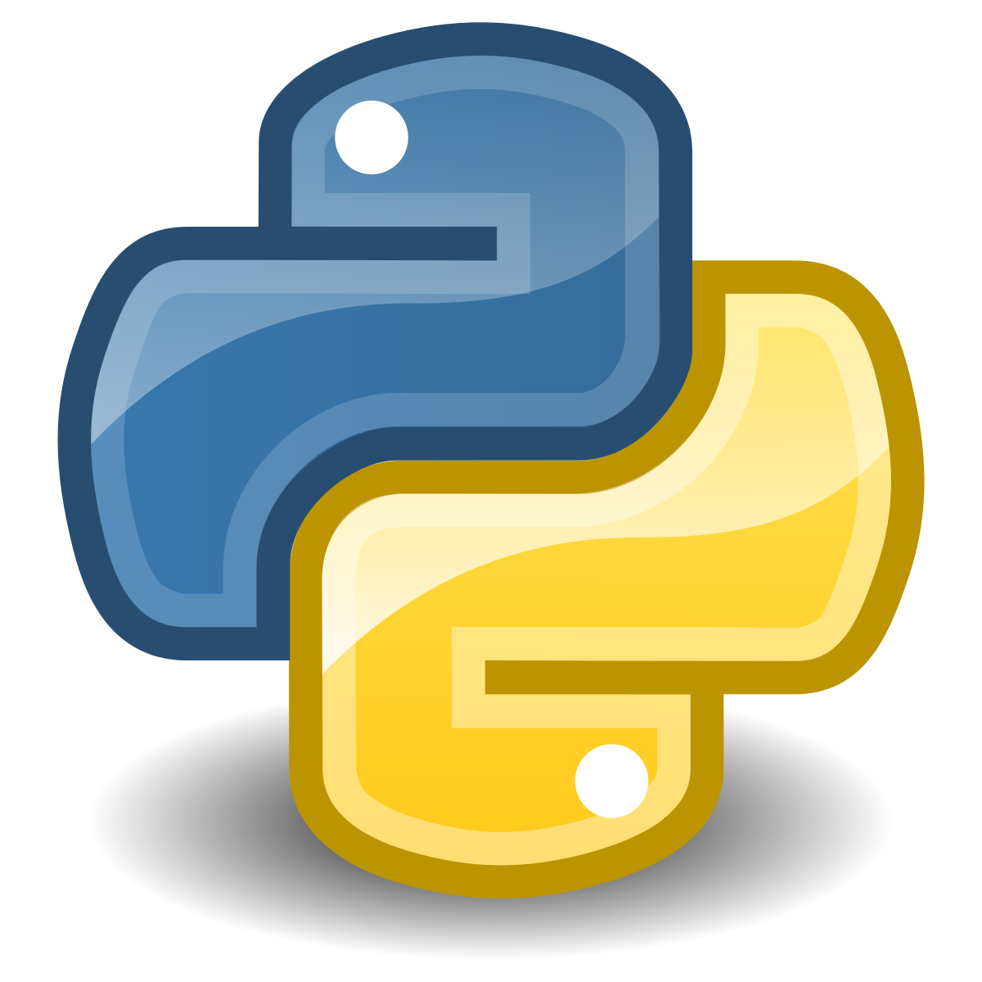
Python
Python is an interpreted high-level general-purpose programming language.
Python's design philosophy:
1- Emphasizes code readability with its notable use of significant indentation.
2- Its language constructs as well as its object-oriented approach aim to help programmers write clear, logical code for small and large-scale projects.

Slide 6
The Python Interpreter
Execution of Python programs is often performed by an interpreter, meaning that program statements are converted to machine executable code at runtime (i.e., when the program is actually run) as opposed to compiled into executable code before it is run by the end user. This is one of the primary ways we'll interact with Python, especially at first. We'll type some Python code and then hit the Enter key. This causes the code to be translated and executed.

Slide 7
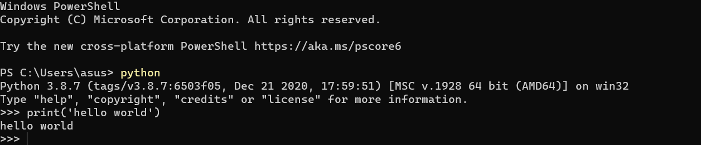
The Python Interpreter
Interpretation allows great flexibility (interpreted programs can modify their source code at run time), but it's often the case that interpreted programs run much more slowly than their compiled counterparts. It's also often more difficult to find errors in interpreted programs.
We can interact with the Python interpreter via a prompt, which looks something like the following.

Slide 8
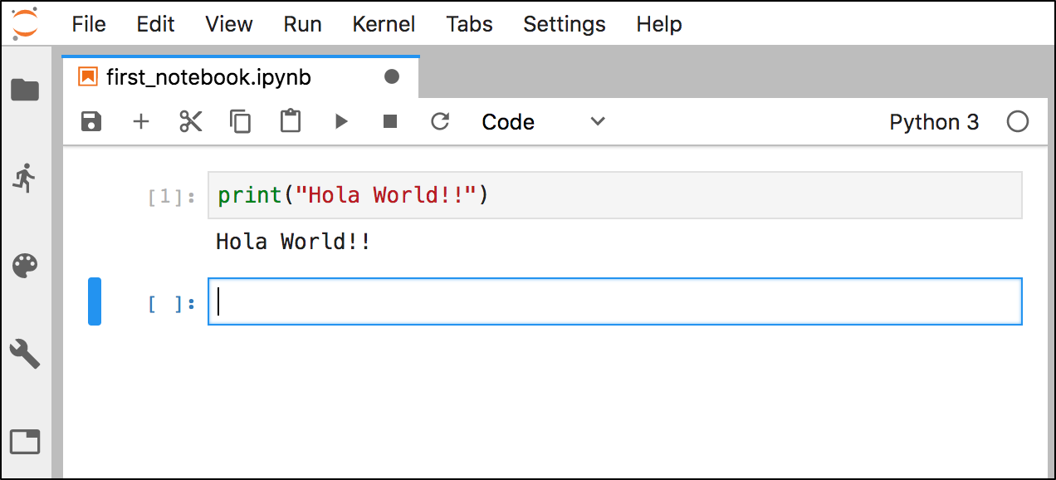
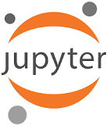
Jupyter Notebooks
We'll also interact with Python using Jupyter Notebooks (like this one). When we hit Run in the menu bar, we are performing an action analogous to hitting enter from a command prompt. The code in the active cell will be executed. Users should be aware that though we are interacting with a Web page, there is a Web server and Python environment running behind the scenes. This adds a layer of complexity, but the ability to mix well-formatted documentation and code makes using Jupyter Notebook worthwhile.

Slide 9

Colab
Colaboratory, or "Colab" for short, allows you to write and execute Python in your browser, with
Zero configuration required
Free access to GPUs
Easy sharing
Whether you're a student, a data scientist or an AI researcher, Colab can make your work easier. Watch Introduction to Colab to learn more, or just get started below!

Slide 10
Let’s start the journey

Slide 11
Python Identifiers and Variables
Identifiers
Variables
An identifier in Python is a word (a string) used to identify a variable, function, class, etc. in a Python program. It can be thought of as a proper name. Identifiers start with a letter (a-Z) or an underscore _; this first character is followed by a sequence of letters numbers, and underscores.
Certain identifiers, such as class or if are built in keywords and cannot be redefined by users.
As in most programming languages, variables play a central role in Python. We need a way to store and refer to data in our programs, and variables are the primary way to do this. Specifically, we assign data values variables using the =. After the assignment has been made, we may use the variable to access the data as many times as we like.

Slide 12
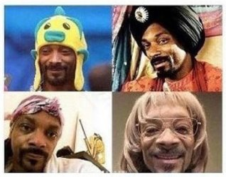
Python Dynamic Typing
Dynamic typing means that the type of the variable is determined only during runtime. Due to strong typing, types need to be compatible with respect to the operand when performing operations. For example, Python allows one to add an integer and a floating-point number but adding an integer to a string produces an error.

Slide 13
Data Types
Text Type: | str
Numeric Types: | int, float, complex
Sequence Types: | list, tuple, range
Mapping Type: | dict
Set Types: | set, frozenset
Boolean Type: | bool
Binary Types: | bytes, bytearray, memoryview
In programming, data type is an important concept.
Variables can store data of different types, and different types can do different things.

Slide 14
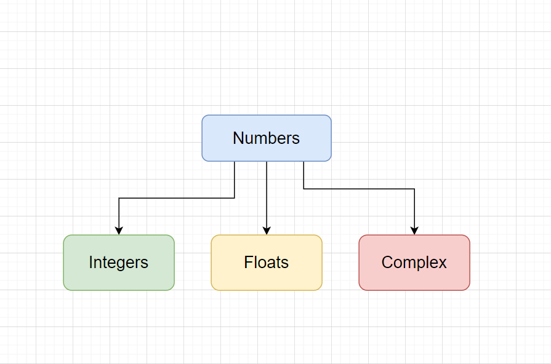
Numbers
he basic numerical data types of python are:
int (integer values),
float (floating point numbers),
complex (complex numbers).
NOTE: Unlike some other languages, Python 3 does not have minimum or maximum integer values (Python 2 does, however).

Slide 15
Arithmetic
Operator | Description | Syntax
+ | Addition: adds two operands | x + y
– | Subtraction: subtracts two operands | x – y
* | Multiplication: multiplies two operands | x * y
/ | Division (float): divides the first operand by the second | x / y
// | Division (floor): divides the first operand by the second | x // y
% | Modulus: returns the remainder when first operand is divided by the second | x % y
** | Power : Returns first raised to power second | x ** y
Arithmetic operators are used to perform mathematical operations like addition, subtraction, multiplication and division.

Slide 16
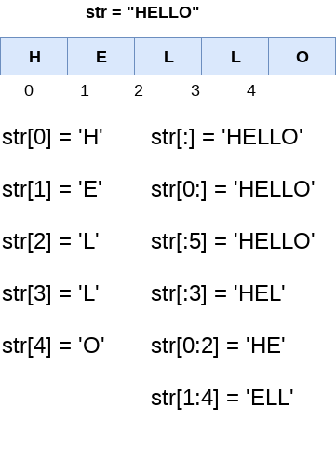
String
String is a collection of alphabets, words or other characters. It is one of the primitive data structures and are the building blocks for data manipulation. Python has a built-in string class named str . Python strings are "immutable" which means they cannot be changed after they are created.

Slide 17
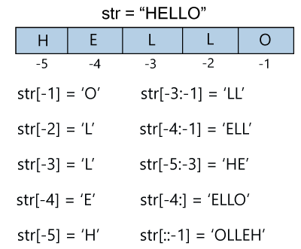
String
String is a collection of alphabets, words or other characters. It is one of the primitive data structures and are the building blocks for data manipulation. Python has a built-in string class named str . Python strings are "immutable" which means they cannot be changed after they are created.

Slide 18
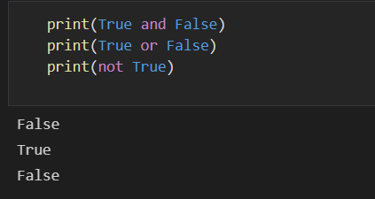
Boolean Values, and None
Python has two Boolean values, `True` and `False`. The normal logical operations (`and`, `or`, `not`) are present.

Slide 19
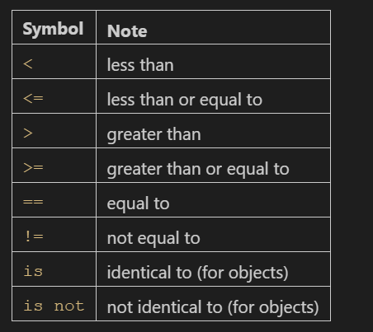
Boolean Comparisons
Regarding the first 6, these will work as expected for numerical values.
Note, however, that they can be applied to other datatypes as well.
Strings are compared on a character-by-character basis, based on a lexicographic ordering. Sequences such as lists are compared on an element-by-element basis.

Slide 20
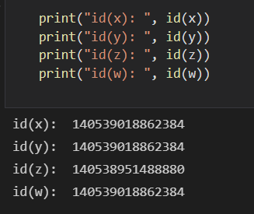
The `id()` function
The `id()` function can be used to identify an object in memory. It returns an integer value that is guaranteed to uniquely identify an object for the duration of its existence.

Slide 21
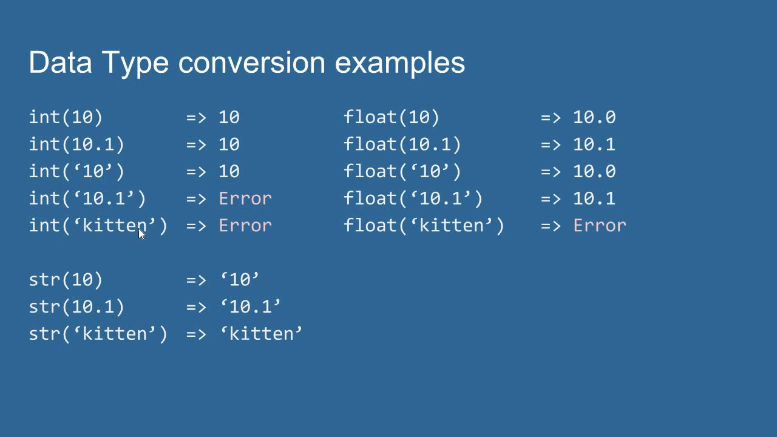
Converting between Types
Values of certain data types can be converted to values of other datatypes (actually, a new value of the desired data type is produced). If the conversion cannot take place (because the datatypes are incompatible), an exception will be raised.

Slide 22
Lists, Tuples, Sets, and Dictionaries

Slide 23
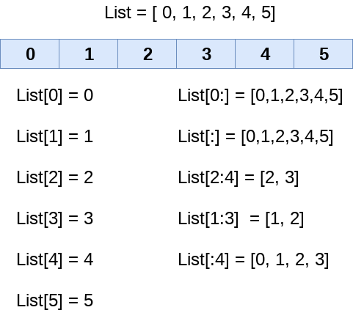
Lists
Many languages (e.g., Java) have what is often called arrays. In Python, the object most like them is called lists. Like arrays in other languages, Python lists are represented syntactically using [...] blocks. Their elements can be referenced via indexes, and just like arrays in other languages, Python lists are mutable objects. That is, it is possible to change the value of an individual cell in a list. In this way, Python lists are unlike Python strings (which are immutable).

Slide 24
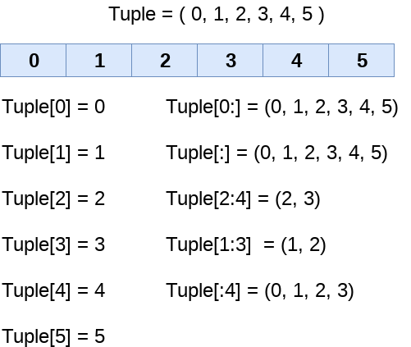
Tuples
There also exists an immutable counterpart to a list, the tuple. Elements can also be referenced by index, but (as with Python strings) new values cannot be assigned. Unlike a list, Tuples are created using either (...) or simply by using a comma-delimited sequence of 1 or more elements.

Slide 25
Sets
{1,2,3,4}
Sets, created using {...} or set(...) in Python, are unordered collections without duplicate elements. If the same element is added again, the set will not change.

Slide 26
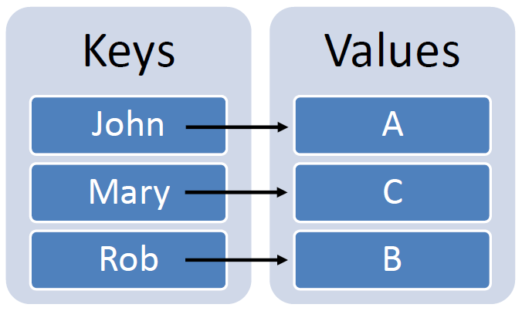
Dictionaries
Dictionaries are collections of key-value pairs. A dictionary can be created using `d = {key1:value1, key2:value2, ...}` syntax, or else from 2-ary tuples using `dictionary()`. New key value pairs can be assigned, and old values referenced, using `d[key]`.

Slide 27
Functions

Slide 28
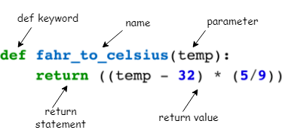
Functions
Functions are "self contained" modules of code that accomplish a specific task. Functions usually "take in" data, process it, and "return" a result. Once a function is written, it can be used over and repeatedly. Functions can be "called" from the inside of other functions.

Slide 29
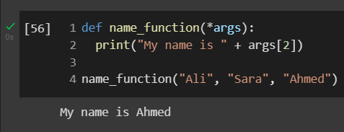
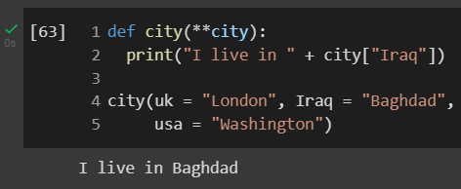
Functions
Arbitrary Arguments (or *args) are used if the no. of arguments is unknown.
Arbitrary Keywords arguments (or **kwargs) are used if the no. of keywords is unknown.

Slide 30
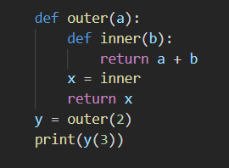
Nested Functions
It's possible to define functions within other functions, and even assign the function to a variable (thereby creating an alias for it). In the below example, `outer` returns a new function, created from argument `a`. The new function is assigned to `y` and then invoked.

Slide 31
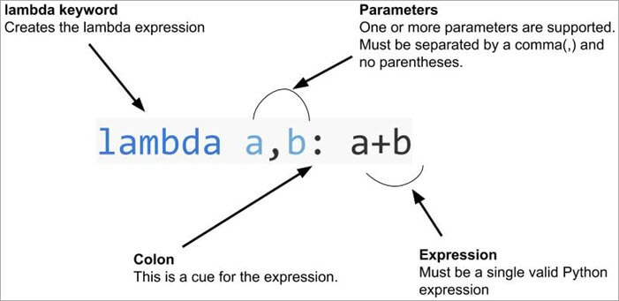
Lambda Function

Slide 32
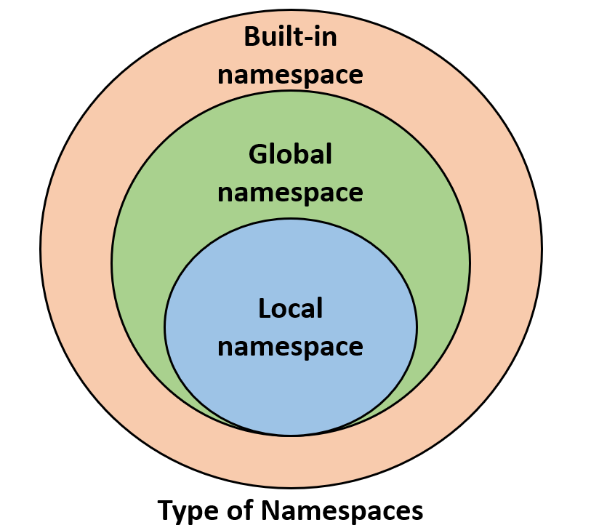
Namespace
A namespace is a system that has a unique name for each object in Python. An object might be a variable or a method. Python itself maintains a namespace in the form of a Python dictionary.

Slide 33
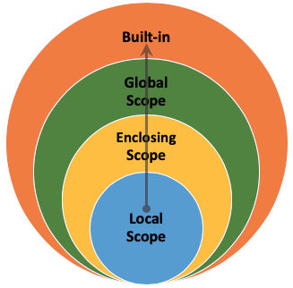
Scope
The scope defines the accessibility of the python object. To access the variable in the code, the scope must be defined as it cannot be accessed from anywhere in the program. The scope defines the set of rules which tell us how and where a variable can be searched.

Slide 34
Math Module

Slide 35
Math
Introduction. The Python Math Library provides us access to some common math functions and constants in Python, which we can use throughout our code for more complex mathematical computations. The library is a built-in Python module, therefore you don't have to do any installation to use it.

Slide 36
Math Functions
Function | Description
min() | Returns minimum value
max() | Returns maximum value
abs() | Returns absolute value
pow() | Returns power of values
sum() | Returns sum of values
round() | Returns nearest integer to its input
Function | Description
sqrt() | Returns the square root of a value
ceil() | Rounds a number up to the nearest integer
exp() | Returns E raised to the power of x
cos() | Returns the cosine of a number
log() | Returns the natural logarithm of a number
pi | Returns PI (3.1415...)
e | Returns Euler's number (2.7182...)
inf | Returns a floating-point positive infinity

Slide 37
OS Module

Slide 38
Os
The OS module in Python provides functions for interacting with the operating system. OS comes under Python's standard utility modules. This module provides a portable way of using operating system-dependent functionality.
What we can do the os module:
Creating a Directory
Listing out Files and Directories
Deleting Directory or Files
Renaming Files
Open files

Slide 39
Glob Module

Slide 40
Glob Module
The glob module is a useful part of the Python standard library. glob (short for global) is used to return all file paths that match a specific pattern.

Slide 41
Control Flow
Conditional Statements and Loops

Slide 42
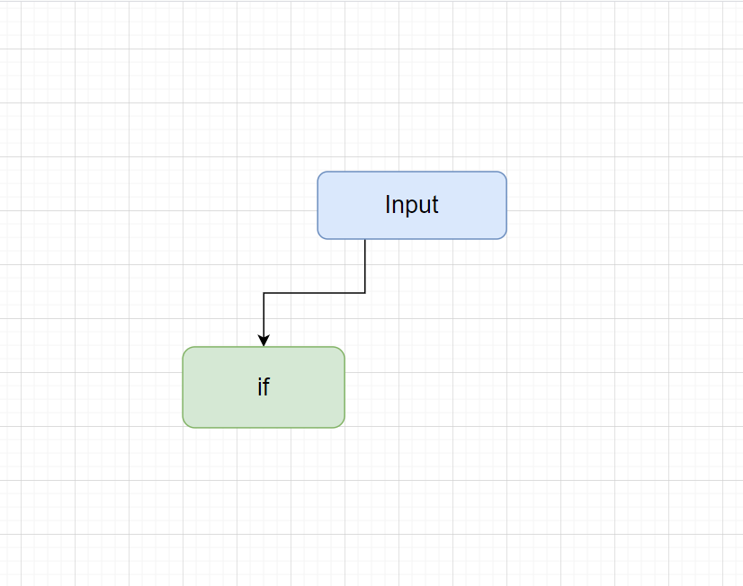
If…Elif…Else
An if statement is a programming conditional statement that, if proved true, performs a function or displays information. Below is a general example of an if statement, not specific to any programming language.

Slide 43
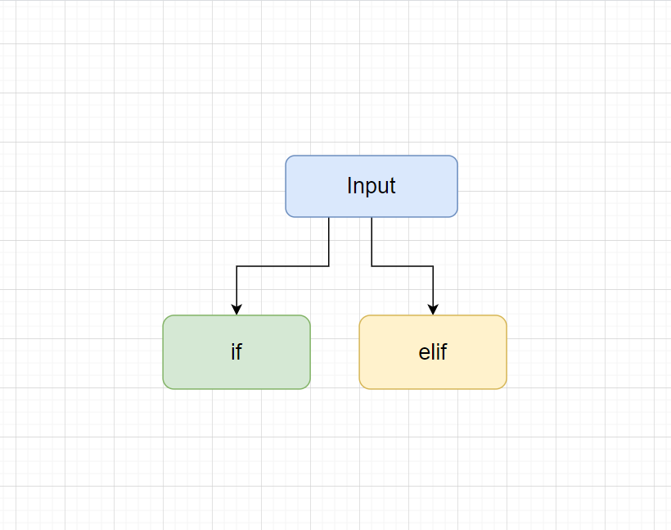
If…Elif…Else
The elif is short for else if. It allows us to check for multiple expressions. If the condition for if is False , it checks the condition of the next elif block and so on. If all the conditions are False , the body of else is executed.

Slide 44
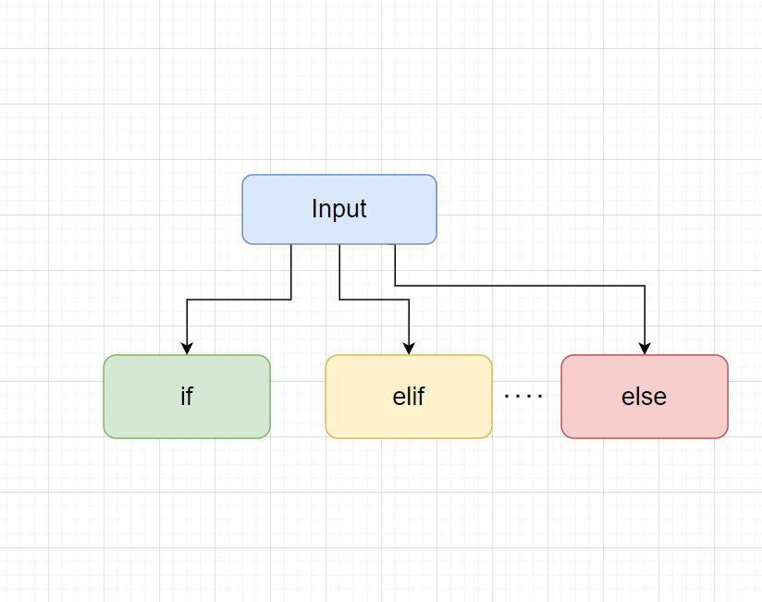
If…Elif…Else
In programming languages, an else statement is an alternative statement that is executed if the result of a previous test condition evaluates to false.

Slide 45
While Loop
Enter While loop
Test Expression
False
A "While" Loop is used to repeat a specific block of code an unknown number of times, until a condition is met. If we (or the computer) knows exactly how many times to execute a section of code (such as shuffling a deck of cards) we use a for loop.
True
Statements
Exit While loop

Slide 46
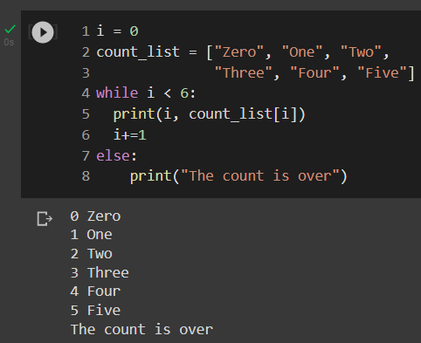
While Loop
we can run a block of code once when the condition no longer is true, using else statement.

Slide 47
For Loop
For each item in sequence
Last item reached
False
A for loop is a control flow statement for specifying iteration, which allows code to be executed repeatedly. For loops are typically used when the number of iterations is known before entering the loop. A for loop is used for iterating over a sequence (that is either a list, a tuple, a dictionary, a set, or a string).
True
Statements
Exit for loop

Slide 48
Classes & Objects

Slide 49

Classes & Objects
Python is an “object-oriented programming language.” This means that almost all the code is implemented using a special construct called classes. Programmers use classes to keep related things together. This is done using the keyword “class” which is a grouping of object-oriented constructs.

Slide 50
What is Class
A class is a code template for creating objects. Objects have member variables and have behavior associated with them. In python a class is created by the keyword class . An object is created using the constructor of the class. This object will then be called the instance of the class.

Slide 51
Attributes and Methods in class
A class by itself is of no use unless there is some functionality associated with it. Functionalities are defined by setting attributes, which act as containers for data and functions related to those attributes. Those functions are called methods.

Slide 53
Thank You

